Slide 1
3D-Reflection
BY:
Parjanya shakya
Manish Pradhan
Anush Hada
Pratik Shrestha

Slide 2
Description
Reflection in computer graphics is used to emulate reflective objects like mirrors and shiny surfaces.
In 3D-reflection the reflection takes place about a plane whereas 2D reflection it used take place about an axis. The matrix in case of pure reflections, along basic planes, viz. X-Y plane, Y-Z plane and Z-X plane.
In two-dimensions there is only one choice of a rotation axis that leaves points in the plane

Slide 3
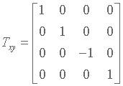
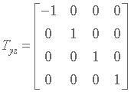
Reflection through different planes
Transformation matrix for a reflection through X-Y plane is:
Transformation matrix for a reflection through Y-Z plane is:

Slide 4
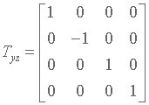
Reflection through different planes
Transformation matrix for a reflection through X-Z plane is:

Slide 5
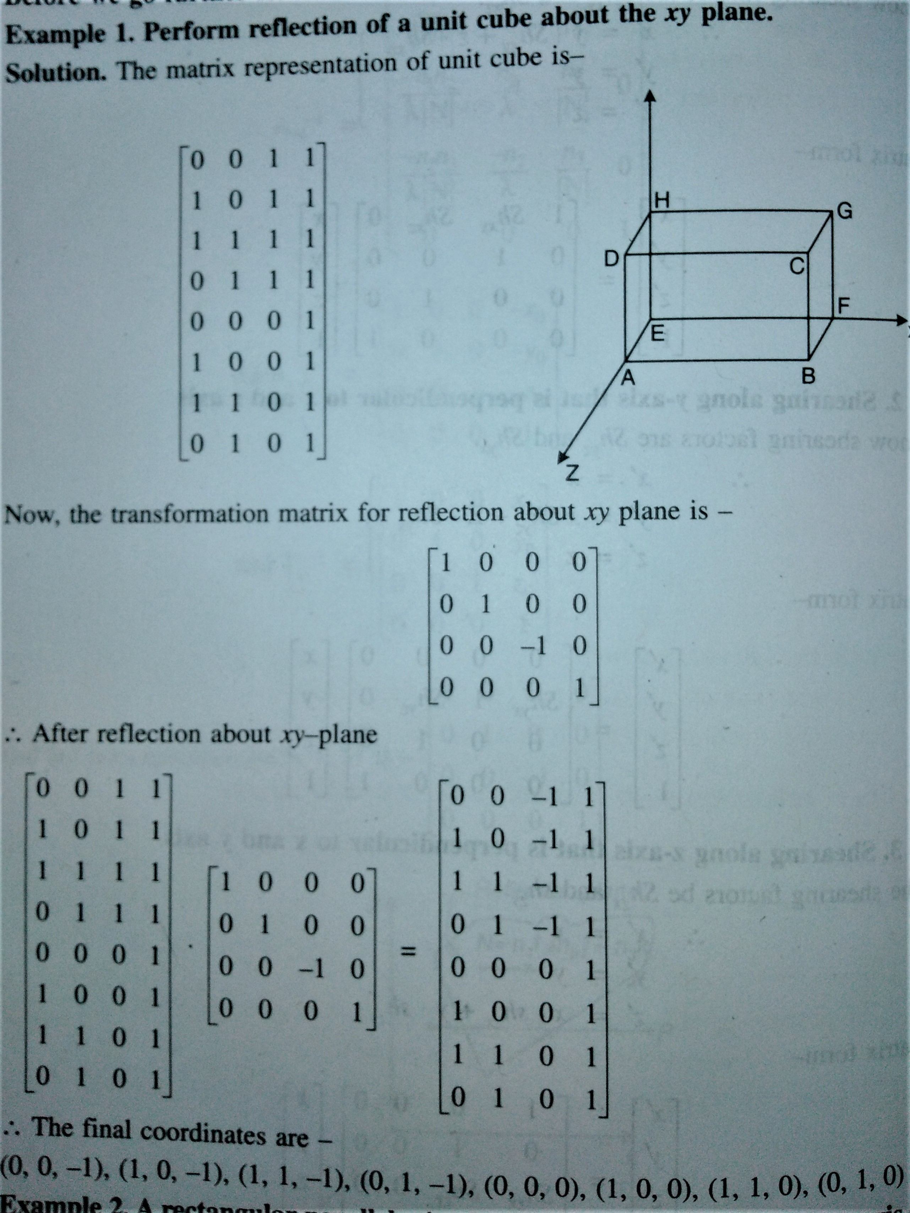
Example:

